Slide 1

Family Scheduling App: Keeping Everyone in sync
Introducing a simple yet powerful website that helps families manage their schedules easily. It improves coordination by keeping everyone on the same page, reducing conflicts and avoiding missed appointments or commitments.

Slide 2

Problem Statement : Solution For Difficulty in Coordinating Family Schedules
Team Members:
Shreyas l arer
Anoop p biradar
Satwik p adiga
Families often struggle to keep track of everyone's busy schedules, leading to missed appointments, forgotten events, and unnecessary stress. The family scheduling app helps families stay organized and connected by:

Slide 3

Streamlining Family Coordination
Centralized Calendar
Easily manage and share family events, activities, and schedules in one centralized platform.
Integrated Reminders
Receive timely notifications and reminders for upcoming events to ensure no commitments are missed.
Improved Communication
Facilitate discussions and updates on schedule changes, keeping the entire family informed.

Slide 4

Language Selector
The Family Scheduling App allows users to select their preferred language from a wide range of options, including English, Spanish, French, German, Arabic, Russian, Portuguese, Indonesian, and more.
This inclusive feature ensures that all family members can access and interact with the app in their native tongue.
This feature implements better communication and understanding within the household and allows multiple language support.

Slide 5





Event Scheduling
Create Event
Add to Google Calendar
Add to Outlook Calendar
Add Notes (Google Keep)
Easily create new events.
Instantly displayed in a centralized table.
Seamlessly integrate with Google Calendar.
Add events to Outlook Calendar.
Take notes on each event.
Google Keep integration.
Keep schedules synchronized.
Complete scheduling control.
Delete Event
Intuitive "Delete" buttons.
Remove unwanted events.

Slide 6
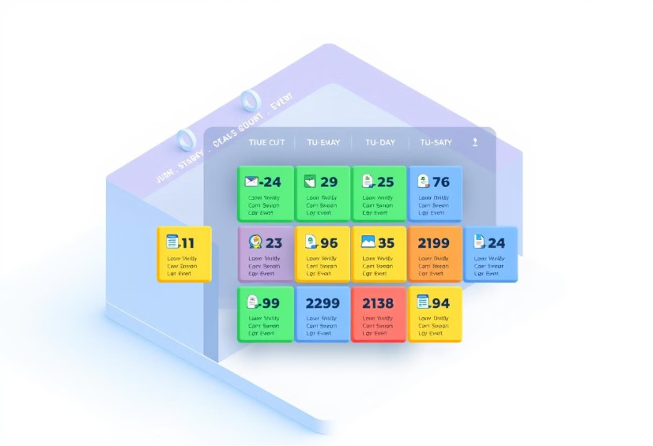

Expense Tracking Made Easy
Event-based Tracking
Reporting and Analysis
Easily track expenses related to family events and activities, ensuring transparency and fairness.
Generate detailed reports on family spending patterns to better manage budgets and plan for the future.

Slide 7
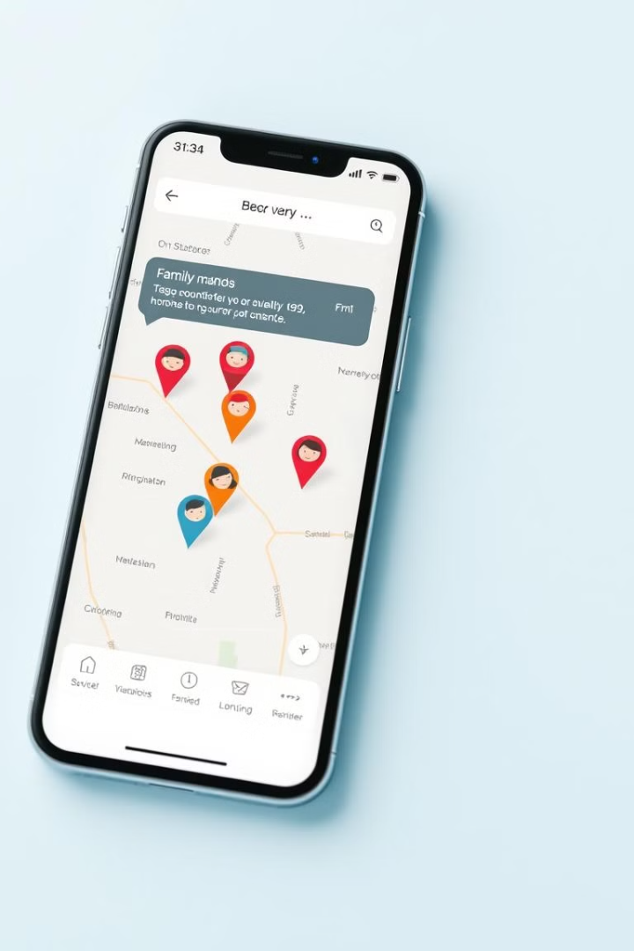
Live Family Locator
1
Real-time Tracking
Monitor the live locations of family members using the app's built-in location services.
2
Arrival Notifications
Receive alerts when family members arrive at their destinations, providing peace of mind.
3
Customizable Settings
Adjust location sharing preferences to maintain privacy and control over the information shared.

Slide 8




Smart Scheduling with AI
Calendar Sync
Seamlessly integrate individual family member calendars to create a unified schedule.
Event Reminders
Set custom reminders for family events to ensure no one misses important commitments.
AI Time Suggestions
AI-powered time suggestions to optimize family time and minimize conflicts.

Slide 9




Stay Connected with Family
Display Location
Share your location with family members for added peace of mind.
Family Messaging
Facilitate real-time communication and discussions within the family through built-in messaging.
Shared Media
Share photos, videos, and important documents within the family to stay connected.

Slide 10
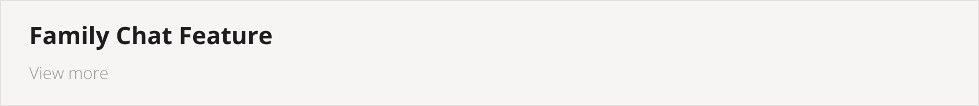



Slide 11

Family Chat Feature
Members can communicate directly about schedules, changes, and other important updates.
This streamlined messaging platform helps keep the family informed and aligned.
It ensures no one misses important information.

Slide 12
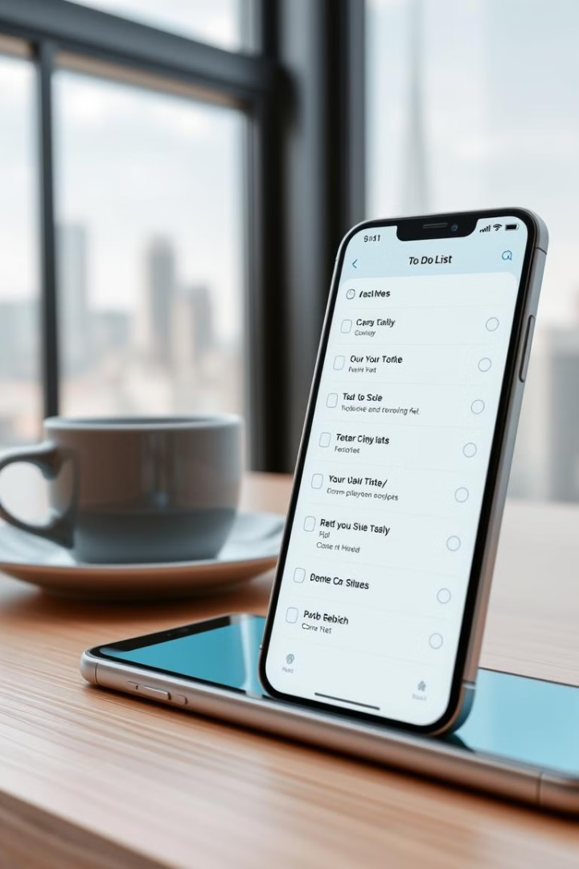
To-Do List
Stay on top of family responsibilities
with the built-in To-Do list.
Easily add tasks
assign them to specific family members, and track progress.
The intuitive interface
makes it simple to manage household chores, errands, and other shared family to-dos.

Slide 13

Excel Export
For those who prefer to analyze data in a spreadsheet, the Family Scheduling App allows users to export their scheduled events to an Excel file using the SheetJS library.
This empowers families to further customize and manipulate their scheduling information to suit their needs.

Slide 14
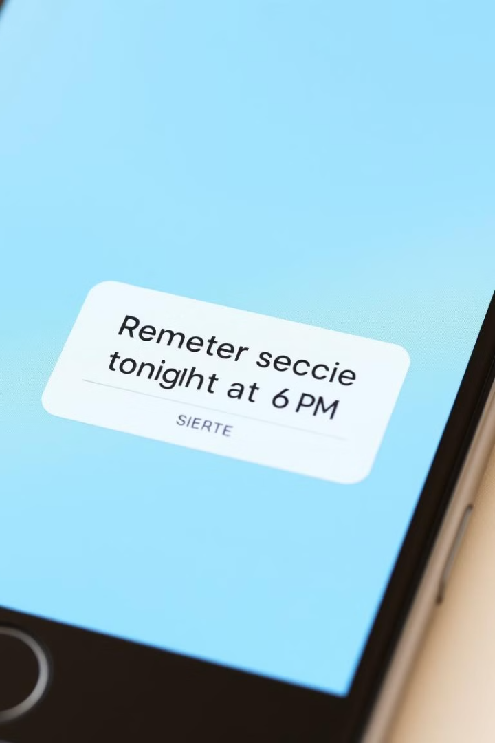
Customizable Notifications
1
Notification Preferences
Customize notification settings for different event types, including email, push, and SMS.
2
Timely Alerts
Receive timely notifications to ensure family members are aware of upcoming events and changes.
3
Prioritized Reminders
Prioritize important events and set personalized reminders to avoid missed commitments.

Slide 15
Technical Implementation Overview of Code
HTML
CSS
JavaScript
The HTML structure defines the app's key sections, including event scheduling, family member customization, AI-powered suggestions, chat functionality, to-do lists, and seamless Excel export capabilities.
The CSS styles ensure the app is responsive and visually appealing across desktop and mobile devices.
The JavaScript code handles user interactions, enabling tasks like adding family members, scheduling events, exporting data to Excel, and facilitating real-time chat.
Learn more about CSS
Learn more about JavaScript
Learn more about HTML
Integrations with popular calendars like Google Calendar and Outlook Calendar provide a seamless scheduling experience for families.

Slide 16

Family Scheduling App: Bringing Families Together
The Family Scheduling App is the ultimate solution for families struggling to coordinate their schedules. By providing a centralized platform for managing events, tracking expenses, and fostering communication, the app helps families stay organized, reduce conflicts, and strengthen their bonds.

Slide 17

Thank You
As we close our journey through the Family Scheduling App, we're reminded of the importance of cherishing the time we have with our loved ones. This app is more than just a tool - it's a way to strengthen the bonds that unite us.
"The family is one of nature's masterpieces." - George Santayana

